Slide 1
Factors affecting the adoption of business intelligence solutions in a public sector organisation
Modiketse Tshehla
The National School of Government
2024 March 05

Slide 2
Outline
Concepts
Introduction
Research problem
Methodology
Framework
Sampling
Key findings
Conclusion

Slide 3
Concepts
Assimilation: awareness and evaluation of the innovation.
Adoption: acceptance of a new innovation on an individual or organisation level.
Diffusion: innovation communicated among members of a social system, over time (Roger, 1995).
Infusion: embedding innovation within an organisation to its fullest potential (Zmud & Apple, 1992).
Data visualisation: information in graphical form
BI solutions:
Notes:
Assimilation:“amounts both to identifying and prioritizing needs and problems on one hand, and to searching the organization’s environment to locate innovations of potential usefulness to meet the organization’s problems” (Rogers 1995, p. 391). The degree to which an innovation ﬁts the problem to be solved will inﬂuence the decision to adopt the innovation.
Infusion: the extent to which the full potential of the innovation has been embedded within an organization's operational or managerial work systems (Zmud & Apple, 1992).

Slide 4
Introduction
Public and private organisations use IS for daily activities.
More capital is invested in technology innovations that generate data.
Data is the new currency in the digital world.
Business Intelligence Solutions leverage the use of data to create valuable information.
Identify factors affecting BIS adoption in SA public sector.
Applicable across other sectors.

Slide 5
Research problem
Decision processes are enabled and enhanced by BIS (Popovič, Hackney, Simões Coelho and Jaklič, 2012).
Expected BIS benefits when adopted at individual and organisational level (Grubljesic and Jaklic, 2015).
BIS implementations fail when not fully accepted and adopted (Olszak, 2016).
The study explored factors that influence BIS adoption.

Slide 6
Methodology
Interpretivism research paradigm.
Exploratory and explanatory Case Study.
Cross-sectional: data collected at a single point in time.
Versatile, relies on direct observations & interviews with those involved.
To learn about the past and present of a phenomenon (Yin, 2018).

Slide 7
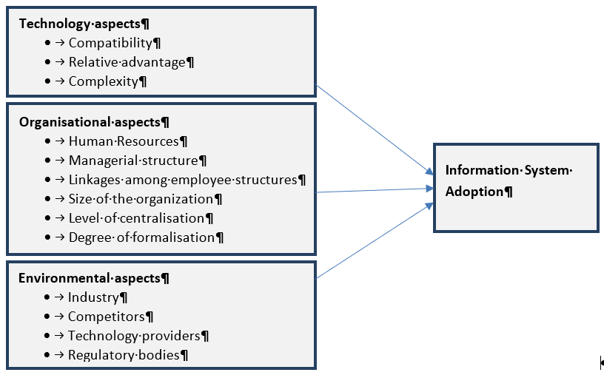
Framework
Technology-Organisation-Environment by Tomatzky and Fleischer (1990)

Slide 8
Sampling and analysis
50% senior managers adopted, another not adopted.
Deductive method followed the conceptual framework.
A priori themes
Technology category
Expected benefits
Compatibility
Organisation category
Organisation size
Available financial resources
Environment category
Competitors
Service provider support

Slide 9
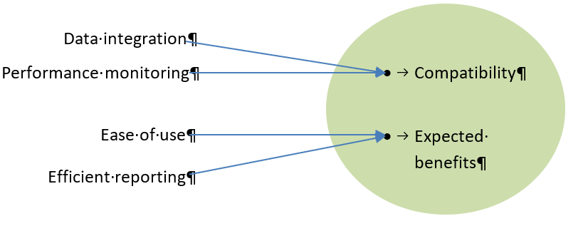
Key findings
Technological Context

Slide 10
Key findings, cont.
Organisational context

Slide 11
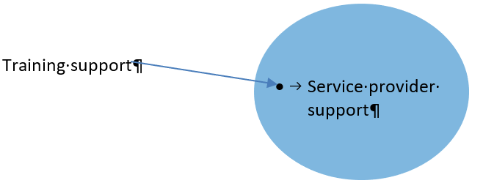
Key findings, cont.
Environment Context

Slide 12
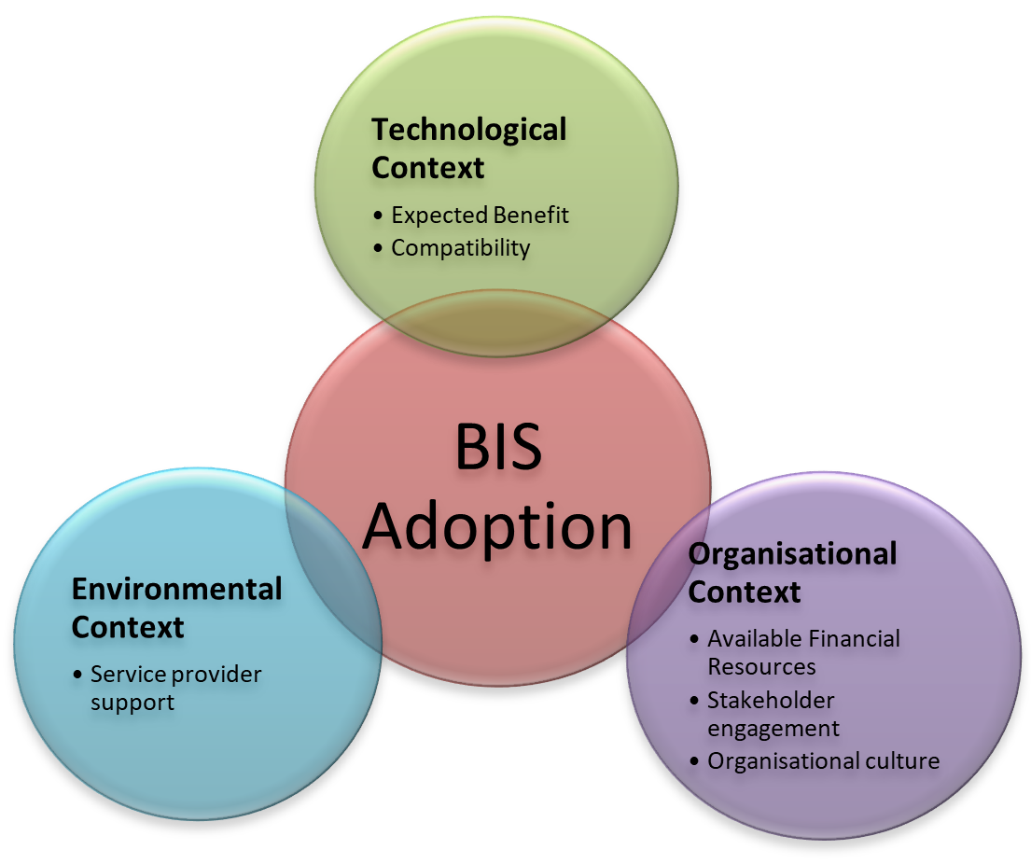
Conclusion
Identified factors affect adoption
TOE framework should be considered

Slide 13
Thank you
Questions
Modiketse Tshehla
Contact: 0827380105
Email: modzan@modiketse.co.za

